Slide 1
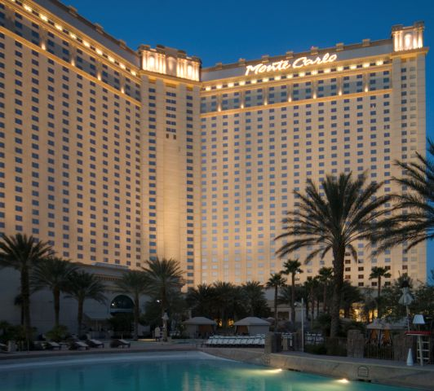
2015 Solidyne Dealer Conference
Customer Presentation by
Art Collins

Slide 2
Collins Controls Associates
Art Collins
art@solidynecolorado.com
Solidynecolorado.com
1039 Sumac Street, Longmont, CO
Solidyne dealer for 15 years

Slide 3
1050 Walnut Street
Boulder Colorado
16 Existing M2 controllers on 3 Aaon VAV RTUs and new KN Boilers as well as exterior lighting, garage exhaust, Space temperatures.
Existing CatNet web appliance used for trending and alarming.
VAV Pnuematic-ectomy on 5 occupied floors. Approximately 40 VAV terminals per floor.

Slide 4
1050 Walnut Street

Slide 5
CatNet

Slide 6
BACnet Router

Slide 7
Unmanaged Switch

Slide 8
1050 Walnut Street

Slide 9
VAV Shaft Adapter

Slide 10
1050 Walnut Street

Slide 11
1050 Walnut Street

Slide 12
1050 Walnut Street

Slide 13
1050 Walnut Street

Slide 14
1050 Walnut Street

Slide 15
1050 Walnut Street

Slide 16
Project details
Existing customer.
$1050.00 per VAV.
Briefly describe how the sale was closed and any useful / shareable details that may help others.

Slide 17
Questions & Feedback ?

Slide 18
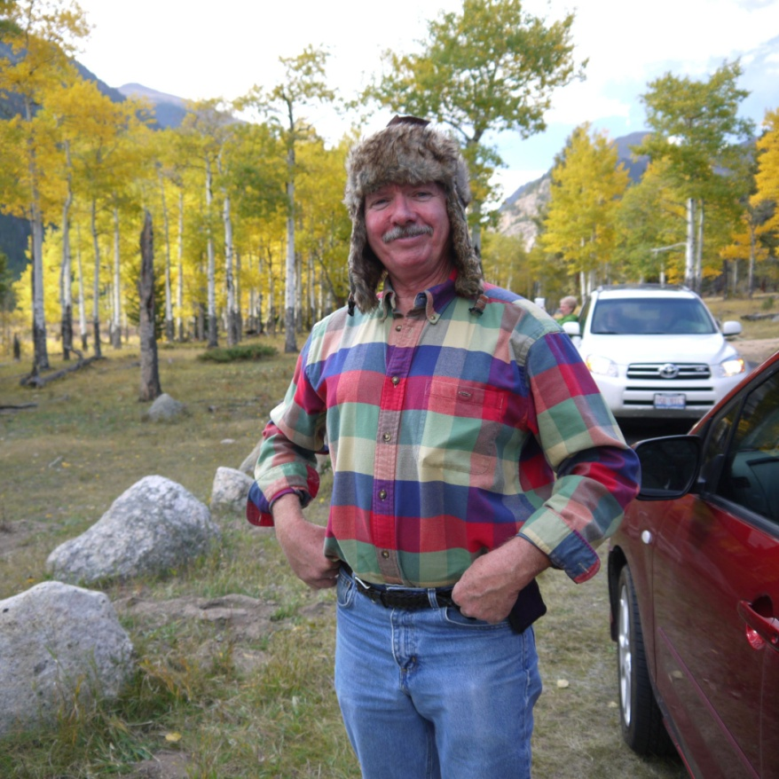
Thank you!
Art Collins

